Slide 1



EXPEDIA
Case Study Presentation
PRESENTED BY:
Alpana Singh - 20BDS0180

Slide 2
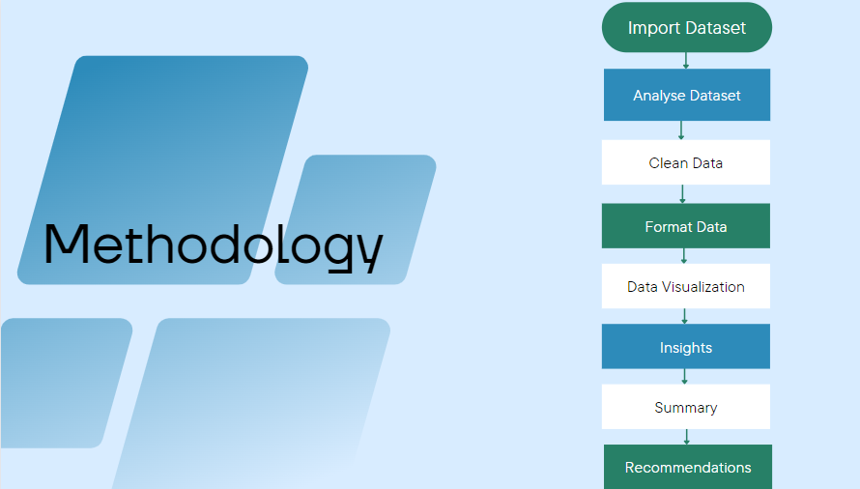

Slide 3
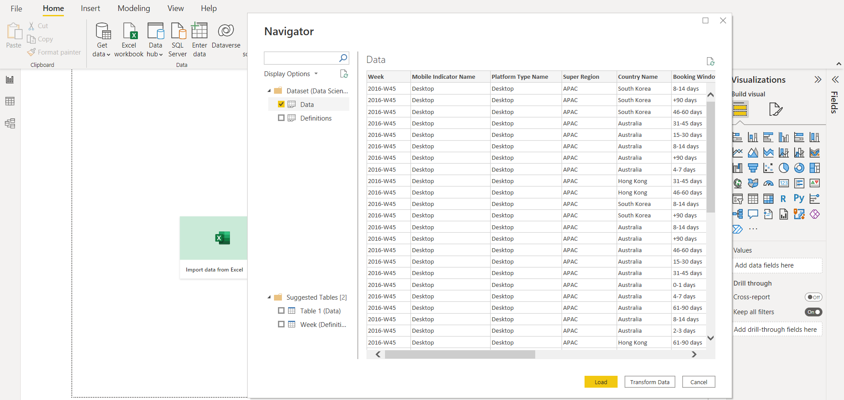
Import Dataset

Slide 4
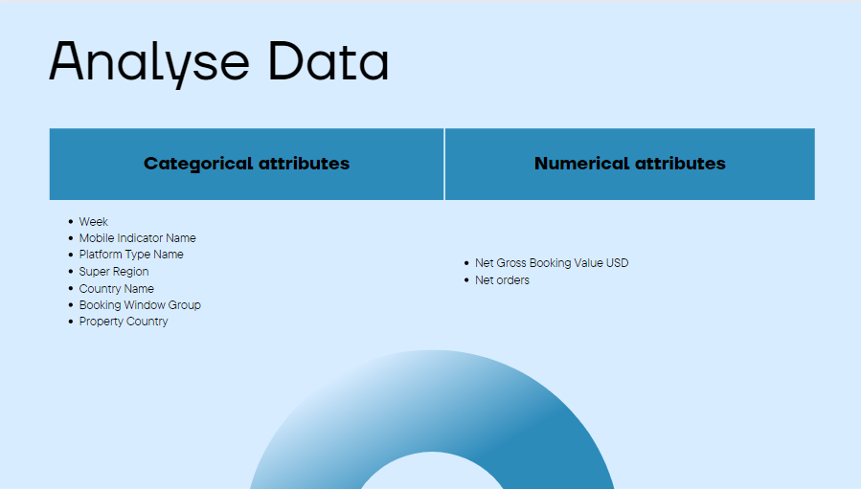

Slide 5
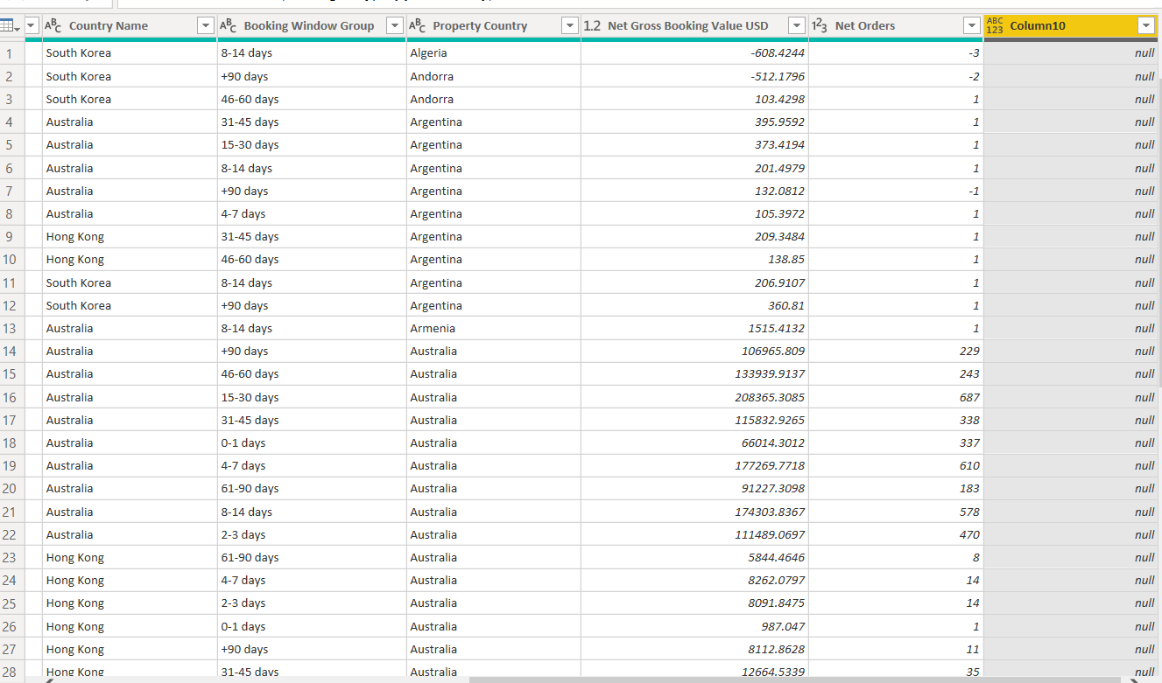
Clean Data
Cleaning data includes fixing incomplete, duplicate or otherwise erroneous data in a dataset.
In the given dataset, there are no incomplete or erroneous values.

Slide 6

Format Data
Formatting the 'Net Gross Booking Value USD' column
Formatting the 'Net Orders' column
Formatting the 'Booking Window Group' column

Slide 7
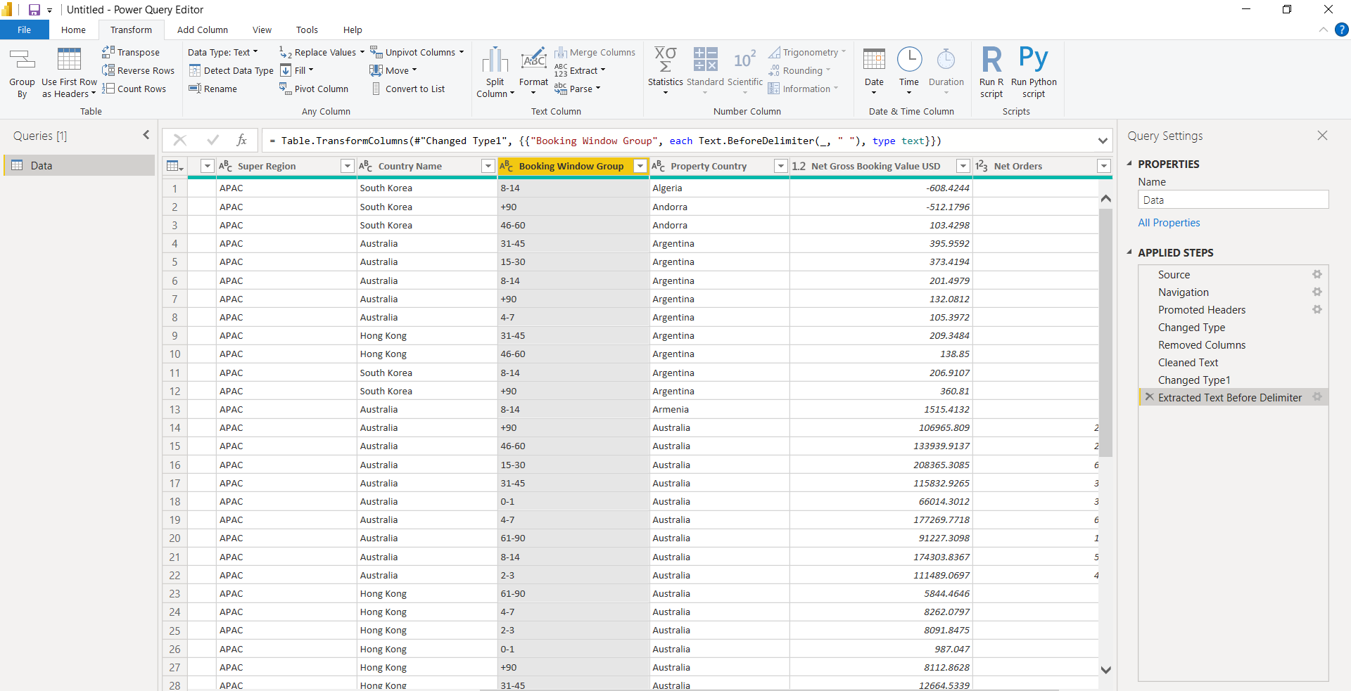
Format Data

Slide 8
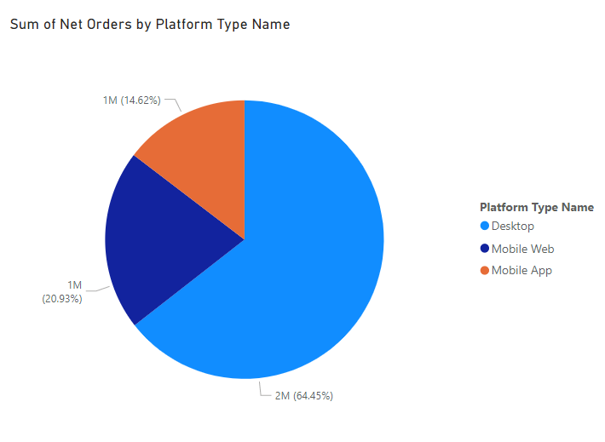
Data Visualizations
INSIGHTS:
Maximum hotel bookings are made using the desktop.
The least preferred platform for hotel booking is the Mobile App.

Slide 9
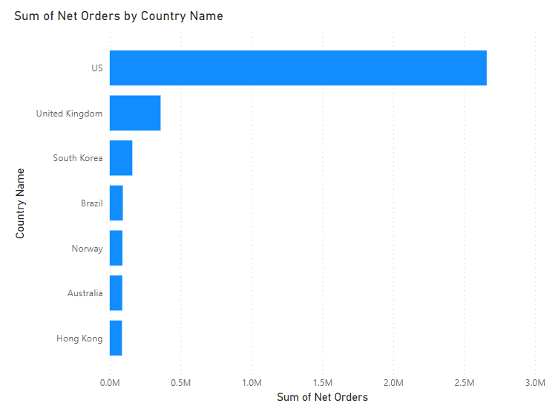
INSIGHTS:
Maximum hotel bookings are made by the travellers originating from US.
The minimum number of bookings are made by the travellers originating from Brazil, Norway, Australia, Hong Kong

Slide 10
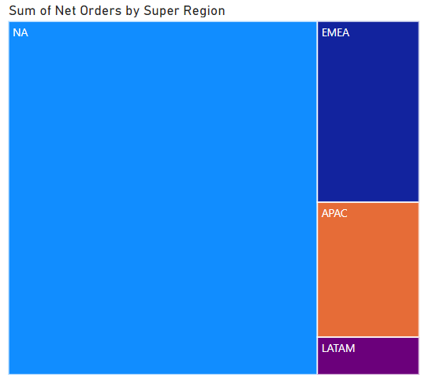
INSIGHTS:
Maximum hotel bookings are made in the NA region and then in EMEA region.
LATAM region made the least amount of hotel bookings.

Slide 11
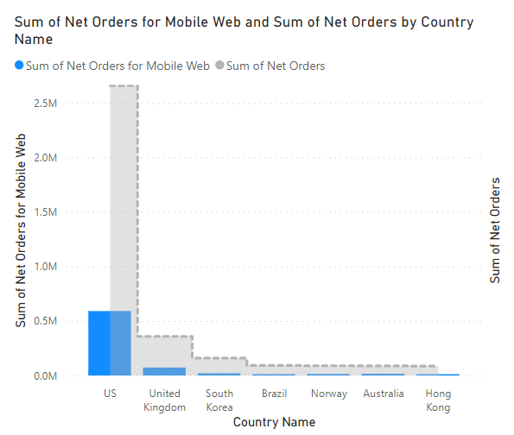
INSIGHTS:
Bookings made through Mobile Web are maximum in US and then in United Kingdom.
People from countries like Hong Kong, Australia do not prefer using Mobile Web for hotel bookings.

Slide 12
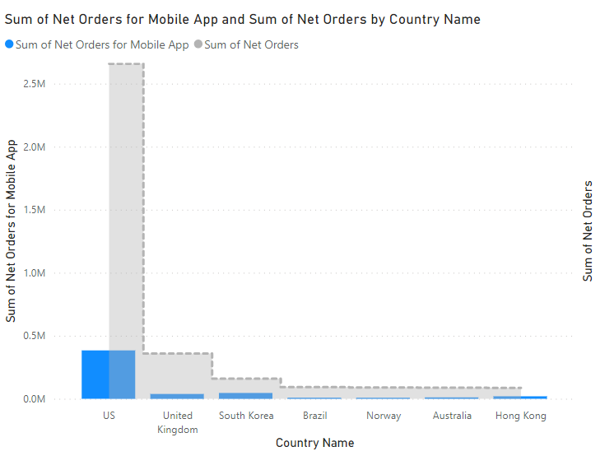
INSIGHTS:
Bookings made through Mobile Apps are maximum in US and then in South Korea.
Most people do not prefer using Mobile Apps for hotel bookings.

Slide 13
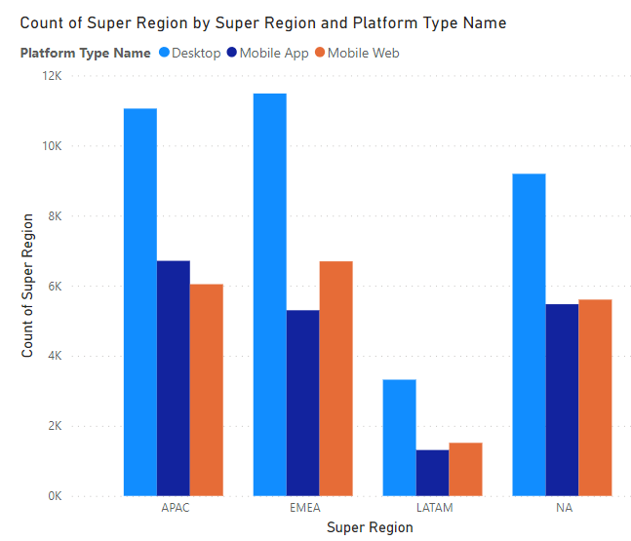
INSIGHTS:
Desktop is the most used platform for hotel booking specially in EMEA and APAC region.
Mobile App and Mobile Web is least used in the LATAM region.
Mobile Web is used more often than Mobile App except APAC region.

Slide 14
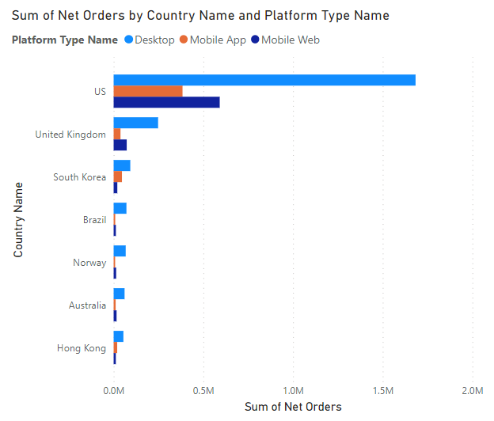
INSIGHTS:
US travellers made the maximum bookings and Hong Kong travellers made the least number of bookings.
Desktop is the most preferred platform for hotel booking in any country.

Slide 15
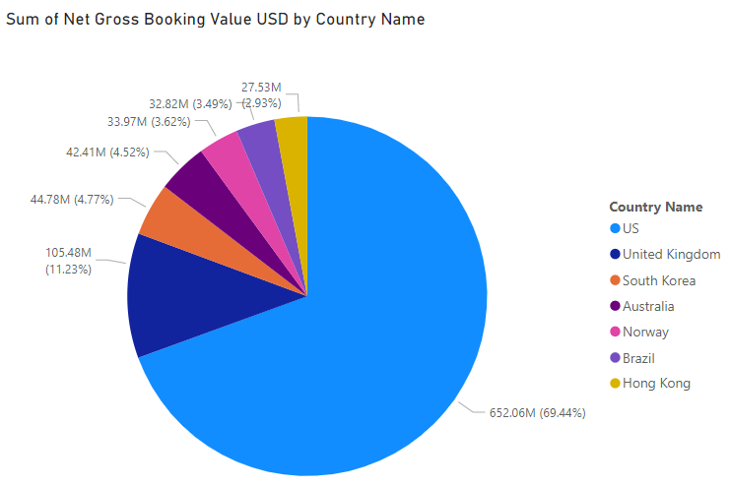
INSIGHTS:
69.44% net gross booking USD is generated by the US travellers.
The least net gross booking USD is generated by Hong Kong travellers.

Slide 16
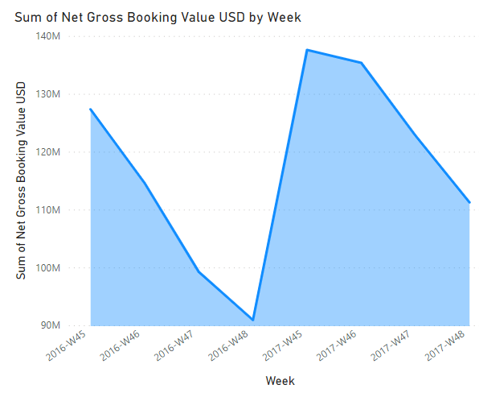
INSIGHTS:
Maximum money spend on bookings is in week 45 of 2016 as well as 2017.
2017 has a great increase in the net gross booking value than 2016.

Slide 17
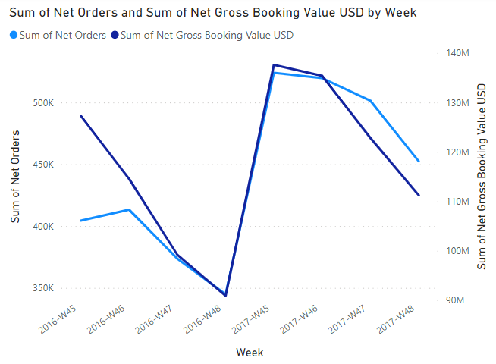
INSIGHTS:
In 2016, the maximum number of bookings were made in week 46 but the highest net gross booking value was achieved in week 45.
In 2017, the maximum number of bookings and the highest net gross booking value was achieved in week 45.

Slide 18
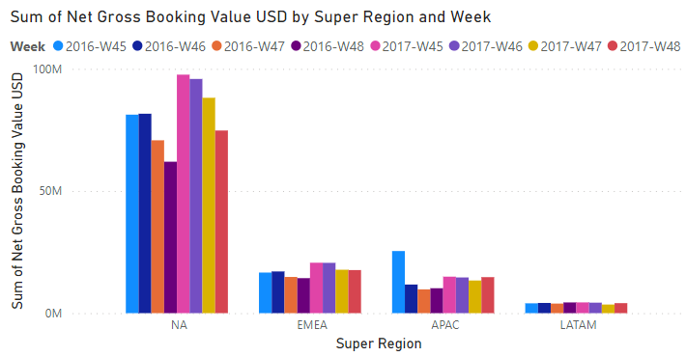
INSIGHTS:
In NA region, the maximum gross booking value was attained in week 45 of 2017.
In EMEA region, the maximum gross booking value was also seen in week 45 of 2017.
In APAC region, the maximum gross booking value was attained in week 45 of 2016.
In LATAM region, the maximum gross booking value was attained in week 45 of 2017.

Slide 19
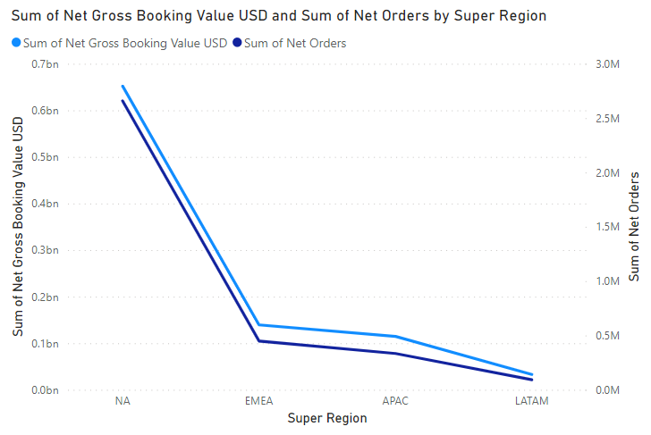
INSIGHTS:
Maximum number of orders and amount is from NA region.
The least number of orders and amount is from LATAM region.

Slide 20
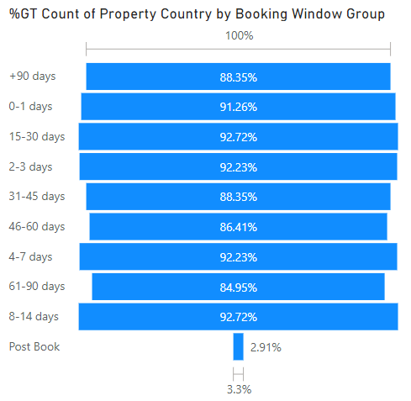
INSIGHTS:
92.72% travellers book the hotels 8-30 days prior to their journey date.
2.91% travellers book the hotels on spot/after their arrival.

Slide 21
Summary
After seeing the insights of different data visualizations, we can conclude that:
Most users prefer using Desktop over Mobile Web or Mobile App to book hotels.
Maximum number of bookings are made by US travellers and then by UK travellers. Thus, these 2 Countries generate the highest net gross booking amount.
The number of orders and the net gross booking amount increases by year.
The maximum gross booking value in 2017 was attained in week 45 for every region but in 2016, it was attained in week 46 for all the regions except APAC . Thus, we can say that the highest net gross booking amount is achieved in week 45 and week 46.
NA region has the highest 'net gross booking value' and 'net orders' value.
Maximum travellers book the hotels 8-30 days prior to their journey date.

Slide 22
Recommendations
Some recommendations that can be helpful are:
In the NA region, maximum users are already using the Desktop for booking hotels. We can promote the beta version of the mobile app and mobile web as they are already familiar with the booking process and can help give feedbacks on the app and website.
Since the highest net gross amount is achieved in week 45 and week 46, we can introduce discounts or some offers on the Mobile device booking window only to increase the Mobile Web and Mobile App marketing.
Some percentage of travellers from US, United Kingdom and South Korea use Mobile App and Mobile Web for booking hotels. We can focus more on the needs and demands of these travellers while they are using Mobile App or Web.

Slide 23
Recommendations
Including the destination region in the dataset will help us visualize the popular regions where travellers visit frequently. This information can help us maximize the profits.
Including the number of cancellation orders in the dataset can help us understand the regions or countries which have the maximum cancellations. By knowing this information we can try to find the possible reasons for cancellation of bookings.

Slide 24

Back to Agenda
Thank You
POWER BI REPOSITORY LINK:
https://app.powerbi.com/groups/me/reports/f0e385a6-7a86-4c2b-bf85-f37337b83ee8?ctid=d4963ce2-af94-4122-95a9-644e8b01624d&pbi_source=linkShare

